Slide 1

Foundations 3
Units 1 - 3

Slide 2
Evaluation Criteria
Written exam 35% (Listening/Voc/Grammar/Reading)
Cambridge platform 20%
Quiz 15%
Speaking exam 15%
Participations/Homework/Writings 15%

Slide 3
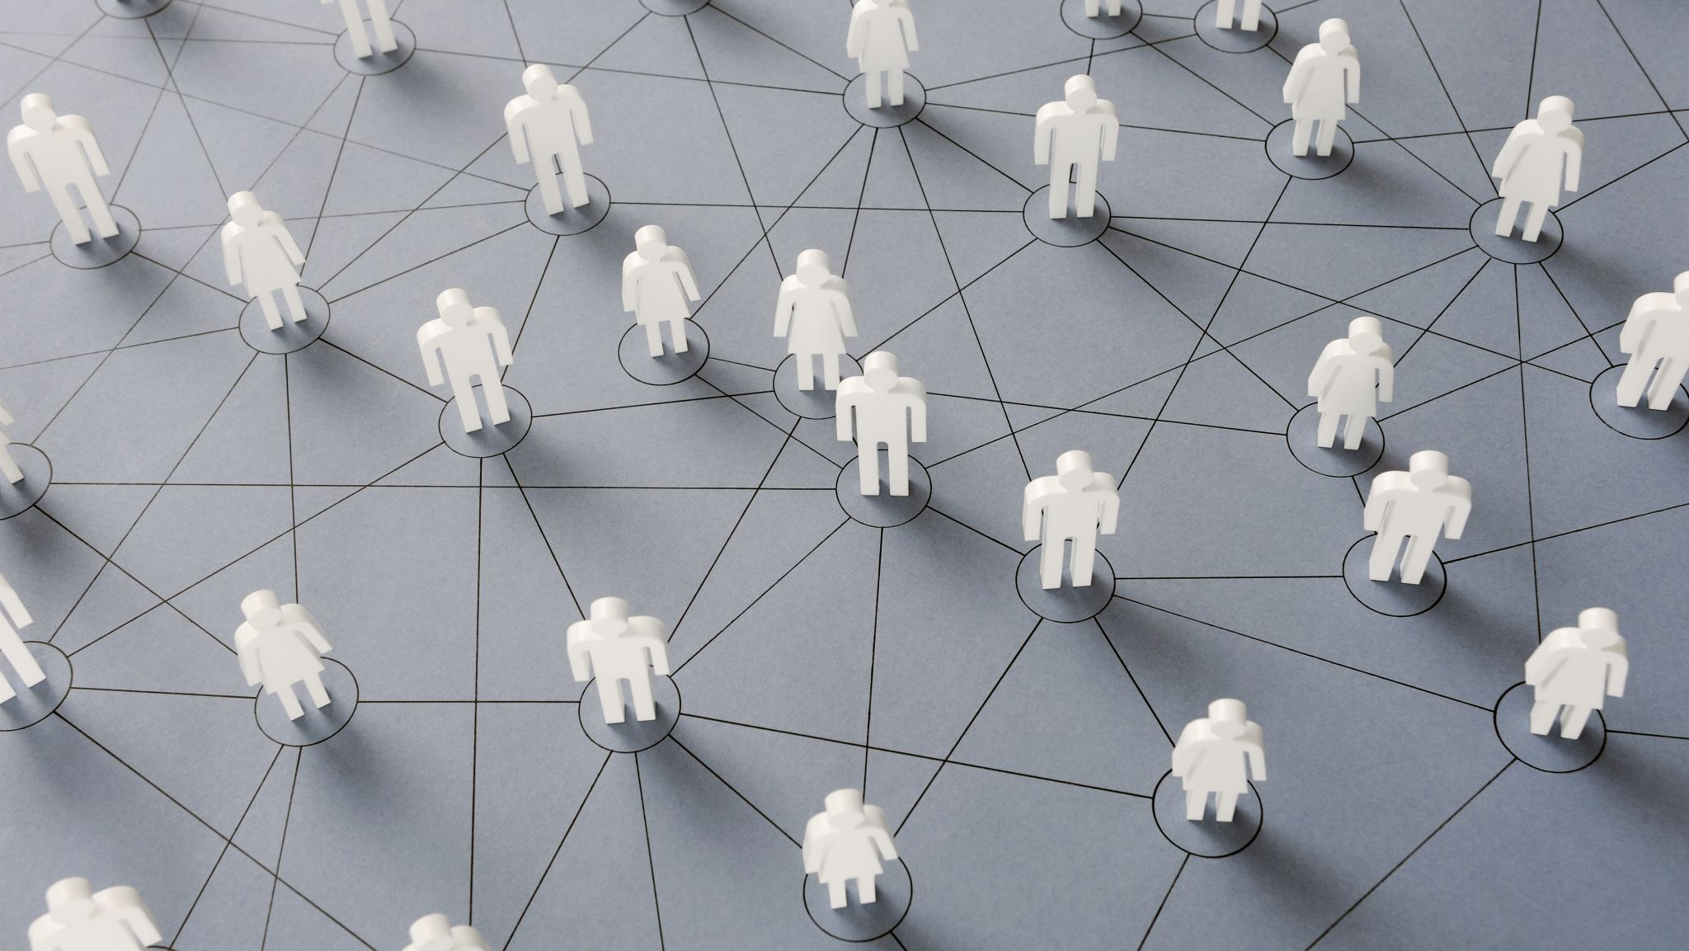
Unit 1 Connections

Slide 4
Verb “To be”
We use “be” to talk about mostly descriptions and states.
Subject | Verb | Affirmative |  | Negative
I | Am | I am | I’m | I am not | I’m not
He, She, It | Is | (He) is | (He)’s | (She) is not | (It)’s not | (She) isn’t
You, We, They | Are | (You) are | (You)’re | (We) are not | (We)’re not | (We) aren’t
Short Question | Short Answer
Am I…? | (+) Yes, S + Be (-) No, S + Be(-)
Is (it)…?
Are (they)…?
Short Question | Short Answer
Am I…? | Affirmative
Is (it)…?
Are (they)…?

Slide 5
Possessive Adjectives
Subject
I
You
Possessive Adjective
My
Your
He
She
It
We
You
They
His
Her
Its
Our
Your
Their
Possessive adjectives are used to describe who is the possessor of an object.
First, we indicate the possessor and next the object to posses.
My
car

Slide 6
Possessive Pronouns
Subject
I
You
Possessive Pronouns
Mine
Yours
He
She
It
We
You
They
His
Hers
Its
Ours
Yours
Theirs
Important information!!!
The possessive pronouns can be both subject or object
Subject: My phone is a Blackview. Yours is an iPhone.
Object: I don’t like your phone. I like hers.
Possessive pronouns are used to substitute both the possessive adjective and object, when we are talking about the same thing.
Original sentence
My phone is a Blackview. Your phone is an iPhone.
Identify context
My phone is a Blackview. Your phone is an iPhone.
Substitute for pronoun.
My phone is a Blackview. Yours is an iPhone.

Slide 7
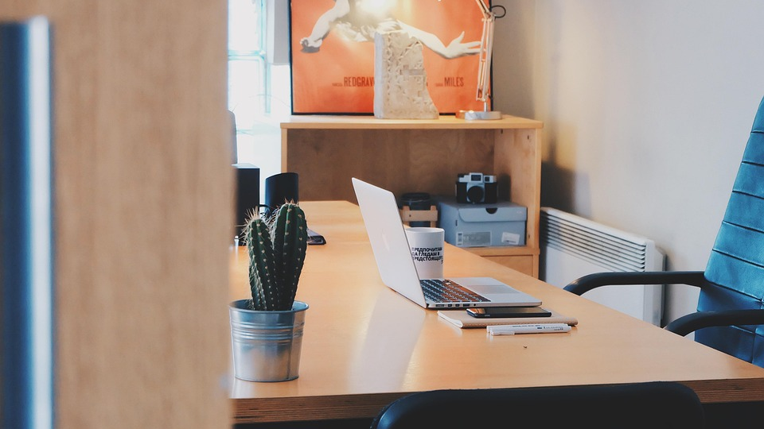
Unit 2 – Work and Study

Slide 8
DO | HAVE | MAKE
🧹 the housework | 🎉 a party | 🛏️ the bed
🍽️ the dishes | 🛋️ free time | 🗓️ plans
🧺 the laundry | 🥨 a snack | 🤔 a decision
💻 some work | 🥤 something to drink | 👋 friends
🔬 research | 😄 a good time | ❌ a mistake
🧘 yoga | 🍝 dinner | 🍳 dinner
 | ☕ coffee | ☕ coffee
DO → Actions or obligations.
HAVE → Experiences and events.
MAKE → Things we create or produce.

Slide 9
Simple Present
Subject | Affirmative | Negative
I, You, We, They | I live in Aguascalientes | I don’t work in a hospital.
He, She, It | She lives in Aguascalientes. | He doesn’t work in a hospital.
The simple present describes habits and general facts about people.
For example:
Tom works at a large company.
I enjoy watching horror films.
They are students.
When using He / She / It in affirmative, we add an “s” to the verb.
Subject | Closed Question | Closed Answer
I, You, We, They | Do you speak French? | Yes, Sub +Aux No, Sub + Aux(-)
He, She, It | Does Robert speak French?
Subject | Open Question | Open Answer
I, You, We, They | Where do you live? | Affirmative
He, She, It | Where does Robert live?

Slide 10
When using he, she and it; we add an extra “s” to the verb
Ending “y” for “ies”
Normal Cases
Dance – Dances
Work – Works
Live – Lives
Try – Tries
Marry – Marries
Fly – Flies
Cry – Cries
Vowel + “Y”
Say – Says
Buy – Buys
Stay – Stays
Ending “s”, “ss”, “sh” or “x”
Wash – Washes
Teach – Teaches
Fix – Fixes
Irregular
Go – Goes
Have – Has
Study – Studies
Play – Plays
Play – Plays
Pass – Passes
Do – Does

Slide 11
Time expressions
In
In the morning
In the afternoon
In the evening
On
On Monday
On Tuesday
Etc.
At
3 o’clock
Night
In the (summer)
Every
Once a…
Twice a…
# times a….
Day
Week
Month
Year

Slide 12
This / That / These / Those
We use This / That / These / Those to identify objects and people at a distance.
Be careful, if the object is singular or plural and if it is near or far.
 | Singular | Plural
Near | This | These
Far | That | Those
We can use them with or with out noun
I like that table.
I don’t like this.
We can use “one” to substitute an object in context.
I don’t like this chair; I like that one.
We can use “ones” to substitute plural objects in context
I love those books; but these ones are awesome.

Slide 13
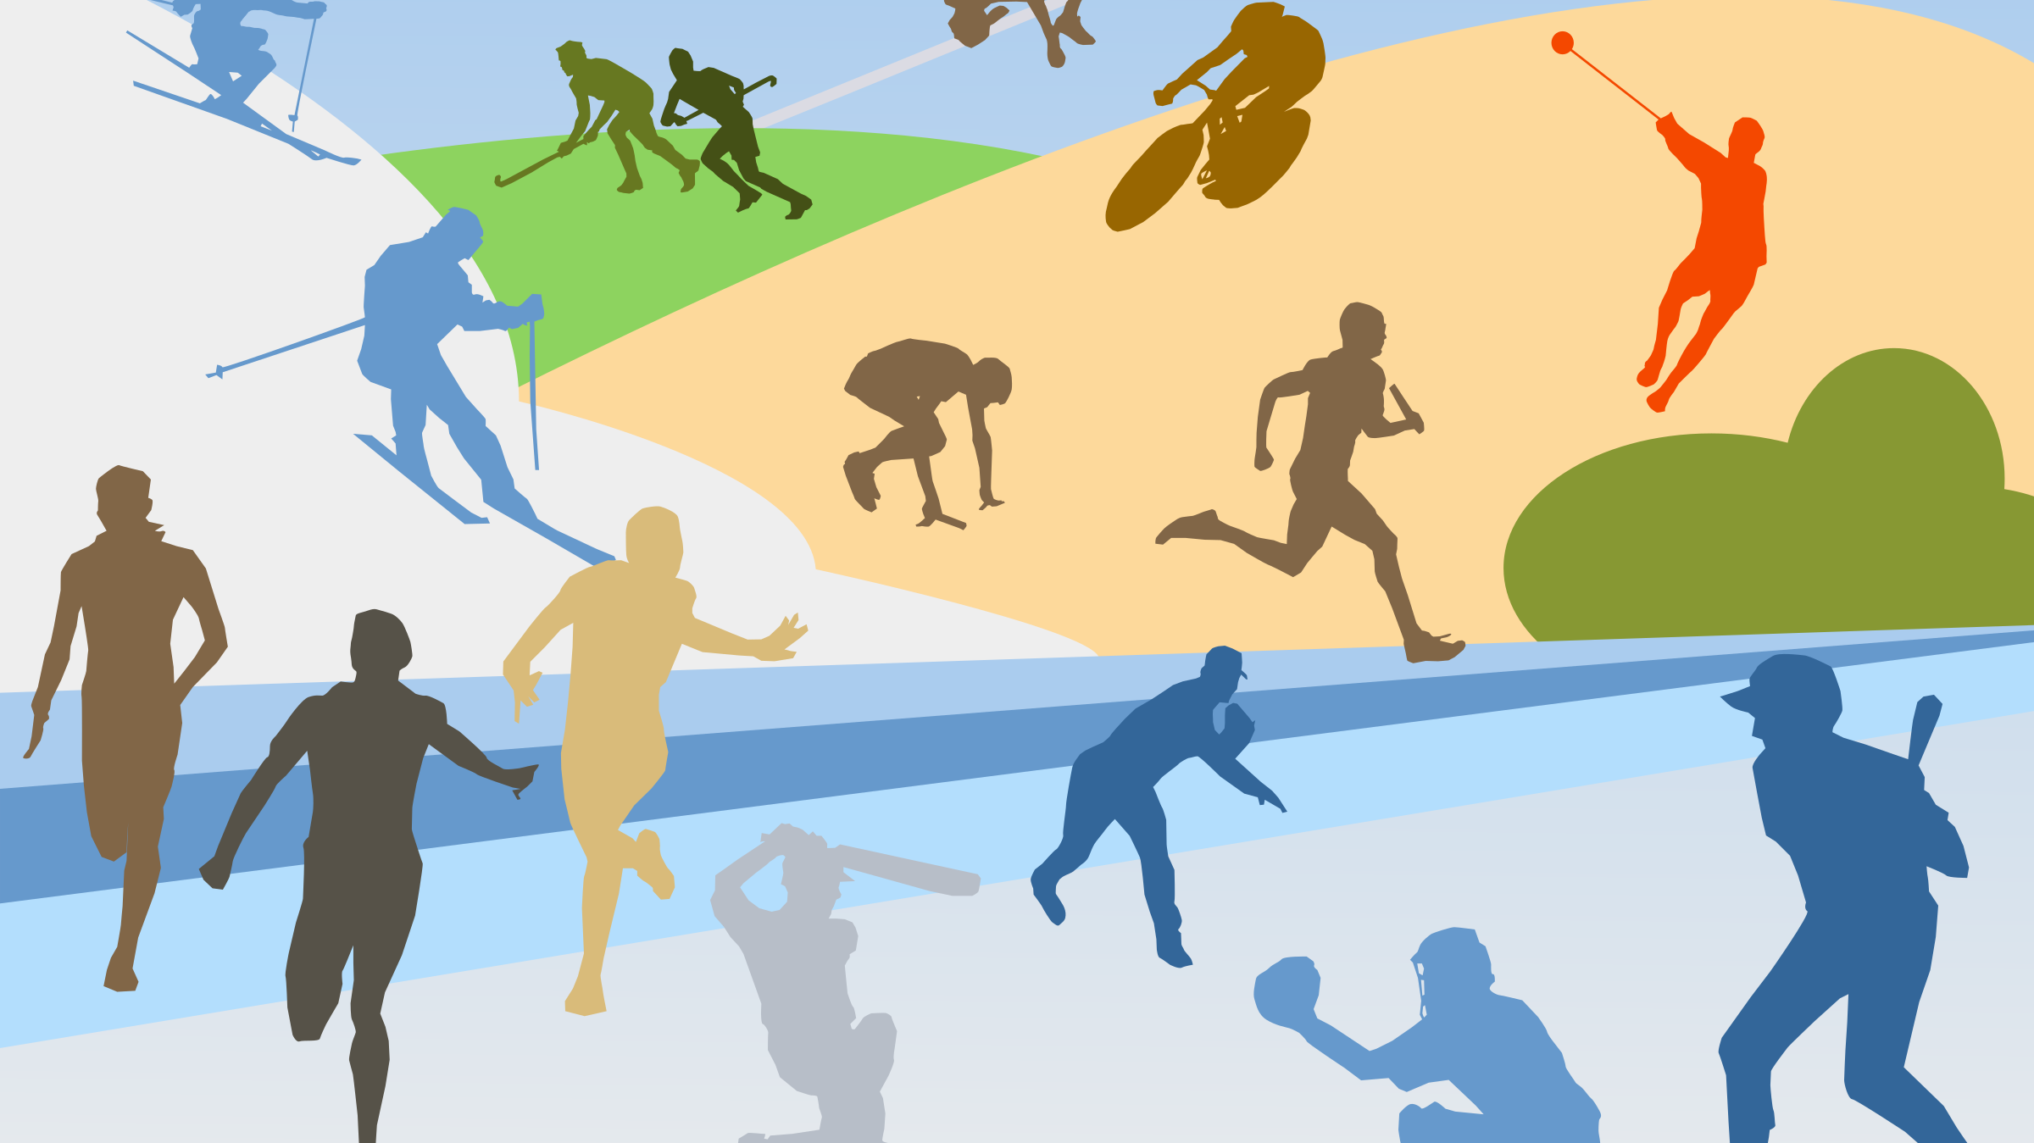
Unit 3 – Let’s move

Slide 14
Present Continuous
Subject | Aux | Affirmative | Negative
I | Am | I am playing the guitar now. | I’m not washing the dishes.
He, She, It | Is | He is playing the guitar now. | She isn’t washing the dishes.
You, We, They | Are | They are playing the guitar now. | They aren’t washing the dishes.
We use the present continuous to talk about actions happening right now or temporary.
In the present continuous, we use the verb "be" with the subject and add "-ing" to the main verb.
Closed question | Closed answer
Am I playing? | Yes, S+ Aux No, S +Aux (-)
Is it raining?
Are they sleeping?
Open question | Open answer
QW + Aux + Sub + Verb (+ Comp)? | Affirmative

